Slide 1
ETL for Data Mart

Slide 2
ETL for the Data Mart
What is a Data Mart?
Subject or Application Oriented Business view of Warehouse
Why do we need data marts
Quick solution to a specific Business Problem
Smaller amount of data used for analytic processing
Finance, Manufacturing, Sales, etc.

Slide 3

Objectives
Surrogate Keys and assignment
SCD Type 6
Denormalization and impact on ETL
Junk Dimensions
Aggregation

Slide 4


Surrogate key
Carla is a librarian. She has recently expanded her library and bought 5 copies each of most frequently borrowed books.
Because of multiple copies of same book she is finding it difficult to keep track of borrower and books.
Can you suggest her better ways to manage her library?
Although each book has a unique name and author combination, when there are multiple copies we need additional mechanism to identity each copy. Probably we can assign a unique number to each book in the library to avoid confusion.

Slide 5
Surrogate key assignment
Surrogate key is a unique record identifier to each record
SurrogateKey | BusinessKey | EmployeeName | Salary | RowValidFrom | RowValidTo
1 | E90995 | John Smith | 40000 | 01/01/2010 | 31/12/2014
23 | E19555 | Bob Brown | 55000 | 01/01/1999 | 31/12/2011
501 | E90995 | John Smith | 35000 | 01/01/2001 | 31/12/2009

Slide 6
Surrogate key lookup and assignment
Surrogate key generation mechanism may vary depending on the requirements, however the inputs and outputs usually fit into the design shown below:
Find existing record
New key =MAX(existing key) +1
Extract from source system
Output with new key
Lookup
In data warehousing surrogate key generation is widely used to maintain slowly
changing dimensions.

Slide 7
Loading Dimensions
An important thing while loading dimension is to check for any changes in existing data.
For some dimensions we might need to maintain history data, while for others only the current value might be useful.
We need to identify how to store data in a dimension considering various logical and business factors.

Slide 8
Loading Dimensions
When DW receives notification that an existing row in dimension has changed it gives out 3 types of responses
Type 1
Type 2
Type 3

Slide 9

Test your understanding
Categorize the following as SCD type 1, type 2 or type 3
Customer name “Cel One Ltd” was incorrect, correct name is Cell One Ltd.
Product group for Pencils changes from “Stationery” to “Writing Supply”
We have two customers named ABC Inc & XYZ Inc. These two have merged to form a new company ABC XYZ Inc.

Slide 10
Solution
SCD type 1
Reason: since it was a correction in the name the old data now belongs to the new name.
2. SCD type 3
Reason: When the product group changes, if at all required we might need only the previous product group and not the entire history.
3. SDC type 2
Reason: The history prior to merger is also important.

Slide 11
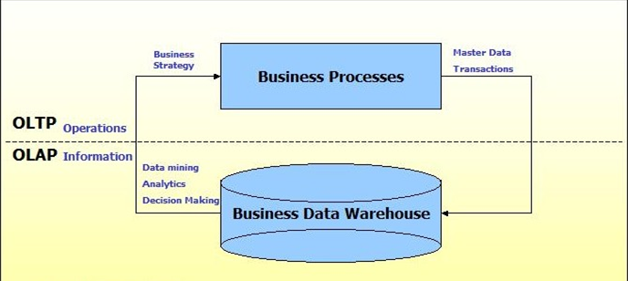
Overview on OLTP and OLAP

Slide 12
OLTP and OLAP
What is OLTP:
On-line Transaction Processing – characterized by a large number of short on-line transactions (INSERT, UPDATE, DELETE). The main emphasis for OLTP systems is put on very fast query processing, maintaining data integrity in multi-access environments and an effectiveness measured by number of transactions per second. In OLTP database there is detailed and current data, and schema used to store transactional databases is the entity model (usually 3NF).
What is OLAP:
On-line Analytical Processing – characterized by relatively low volume of transactions. Queries are often very complex and involve aggregations. For OLAP systems a response time is an effectiveness measure. OLAP applications are widely used by Data Mining techniques. In OLAP database there is aggregated, historical data, stored in multi-dimensional schemas (usually star schema).

Slide 13
Schemas Overview
What is Star schema?
A star schema model can be depicted as a simple star: a central table contains fact data and multiple tables radiate out from it, connected by the primary and foreign keys of the database. In a star schema implementation, Warehouse Builder stores the dimension data in a single table or view for all the dimension levels.
What is Snowflake schema?
The snowflake schema represents a dimensional model which is also composed of a central fact table and a set of constituent dimension tables which are further normalized into sub-dimension tables. In a snowflake schema implementation, Warehouse Builder uses more than one table or view to store the dimension data. Separate database tables or views store data pertaining to each level in the dimension

Slide 14
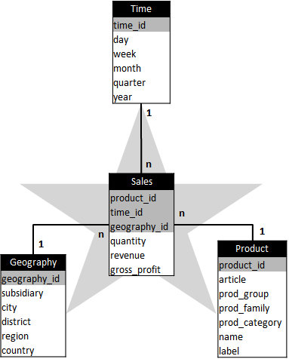
Star Schema
Example:
The dimension tables (Time, Geography and Product) are grouped around the central fact table (Sales) as points of a star are grouped around its center

Slide 15
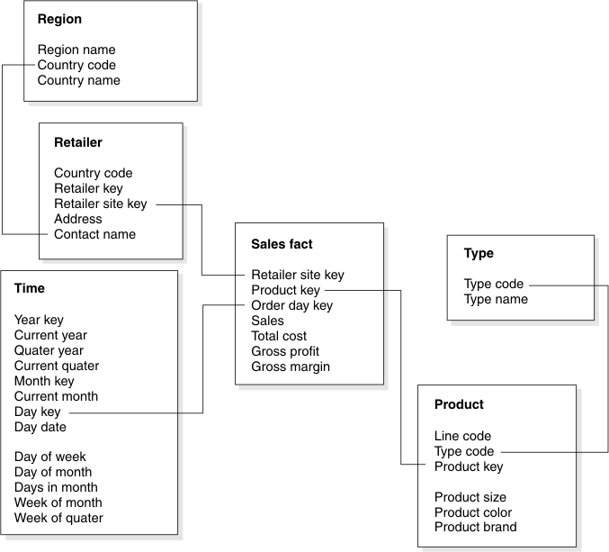
Snowflake schema
Example:
Sales fact table with Retailer, Region, Time, Product, and Type dimension tables.
The primary key in each dimension table is joined to the corresponding foreign key in another dimension table.

Slide 16
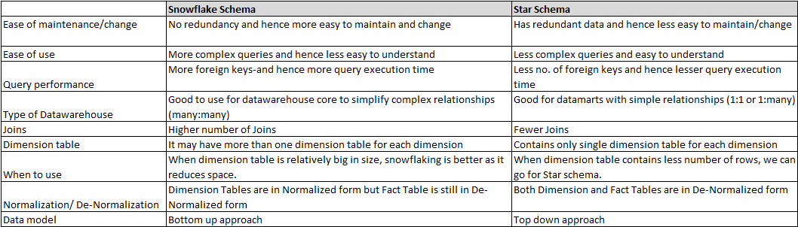
Comparison
Star and Snowflake Schemas comparison:

Slide 17
SCD type 6
SCD Type 6 combines the three basic types. Type 6 is particularly applicable if you want to maintain complete history and would also like have an easy way to effect on current version
Product_SK | Prod_CD | Prod_NM | Prod_Grp_NM | Effective_dt | End_dt | Curr_Prod_Grp_NM
1001 | 1 | Pencil | Stationery | 01-Jan-2012 | 15-Aug-2012 | Writing Supply
1002 | 2 | Pen | Writing Supply | 01-Jul-2012 | 31-Dec-9999 | Writing Supply
1050 | 1 | Pencil | Writing Supply | 16-Aug-2012 | 31-Dec-9999 | Writing Supply
In the above example product group for ‘Pencil’ changes and we have applied SCD type 2 and type 3

Slide 18
SCD type 6
On the next pencil’s product group change (1 July 2010), we will again apply all three SCD types
Product_SK | Prod_CD | Prod_NM | Prod_Grp_NM | Effective_dt | End_dt | Curr_Prod_Grp_NM
1001 | 1 | Pencil | Stationery | 01-Jan-2012 | 15-Aug-2012 | Legacy Supply
1002 | 2 | Pen | Writing Supply | 01-Jul-2012 | 31-Dec-9999 | Writing Supply
1050 | 1 | Pencil | Writing Supply | 16-Aug-2012 | 12-Jan-2013 | Legacy Supply
1115 | 1 | Pencil | Legacy Supply | 13-Jan-2013 | 31-Dec-9999 | Legacy Supply

Slide 19
Denormalization and impact on ETL
Denormalization is the process of attempting to optimize the read performance of a database by adding redundant data or by grouping data
EMPLOYEE and DEPARTMENT are two normalized tables
Employee
Department
Emp_Id | Emp_Nm | Address | Dept _Id
1001 | Andy Smith | New York | D1
1002 | Rachael Jane | Paris | D2
1003 | Nancy Wayne | London | D1
Dept_Id | Dept_Nm
D1 | Finance
D2 | Admin
Every time you want to get the department for a particular employee, you will have to join these two tables

Slide 20
Denormalization and impact on ETL
If we want to frequently fetch department for a particular employee we can denormalize the two tables.
Table after denormalization
Emp_Id | Emp_Nm | Address | Dept _Id | Dept_Nm
1001 | Andy Smith | New York | D1 | Finance
1002 | Rachael Jane | Paris | D2 | Admin
1003 | Nancy Wayne | London | D1 | Finance

Slide 21


Denormalization and impact on ETL
Can you tell me why data is stored in normalized format in DW?
save most storage
simple to understand
Are there any disadvantages of normalization?
bad performance with multiple joins
changes are very difficult to handle

Slide 22

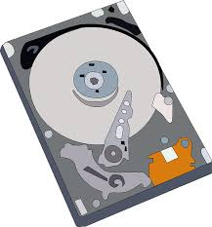
Denormalization and impact on ETL
Why is denormalization required?
Denormalization is a time-space trade-off
Denormalization is done for faster data retrieval (in case of reporting)
Avoid a certain number of queries
Remove joins
The critical issues in denormalizing are
Deciding what data to duplicate and why
Planning how to keep the data in synch
Refactoring the queries to use the denormalized fields.

Slide 23
Populating “junk” dimensions using a Cartesian product
In data warehouse design, frequently we run into a situation where there are yes/no indicator fields in the source system. Through business analysis, we know it is necessary to keep such information in the fact table. However, if keep all those indicator fields in the fact table, not only do we need to build many small dimension tables, but the amount of information stored in the fact table also increases tremendously, leading to possible performance and management issues.
Junk dimension is the way to solve this problem. In a junk dimension, we combine these indicator fields into a single dimension. This way, we'll only need to build a single dimension table, and the number of fields in the fact table, as well as the size of the fact table, can be decreased. The content in the junk dimension table is the combination of all possible values of the individual indicator fields.

Slide 24


Populating “junk” dimensions using a Cartesian product
Let's look at an example. Assuming that we have the following fact table:
FACT_TABLE
In this example, the last 3 fields are all indicator fields. In this existing format, each one of them is a dimension. Using the junk dimension principle, we can combine them into a single junk dimension
CUSTOMER_ID
PRODUCT_CD
TXN_ID
STORE_ID
TXN_AMT
COUPON_IND
PREPAY_IND
TXT_CODE

Slide 25
Populating “junk” dimensions using a Cartesian product
FACT_TABLE
DIM_JUNK
JUNK_ID | TXN_CODE | COUPON_IND | PREPAY_IND
1 | 1 | Y | Y
2 | 2 | Y | Y
3 | 3 | Y | Y
4 | 1 | Y | N
5 | 2 | Y | N
6 | 3 | Y | N
7 | 1 | N | Y
8 | 2 | N | Y
9 | 3 | N | Y
10 | 1 | N | N
11 | 2 | N | N
12 | 3 | N | N
CUSTOMER_ID
PRODUCT_CD
TXT_ID
STORE_ID
TXN_AMT
JUNK_ID
Note that now the number of dimensions in the fact table went from 7 to 5.

Slide 26
Populating “junk” dimensions using a Cartesian product
In this case, we have 3 possible values for the TXN_CODE field, 2 possible values for the COUPON_IND field, and 2 possible values for the PREPAY_IND field. This results in a total of 3 x 2 x 2 = 12 rows for the junk dimension table.
By using a junk dimension to replace the 3 indicator fields, we have decreased the number of dimensions by 2 and also decreased the number of fields in the fact table by 2. This will result in a data warehousing environment that offer better performance as well as being easier to manage.

Slide 27
Aggregation
The data aggregation is a three step process
Step 1 - Read all the input data set rows.
Step 2 - Group the rows read in step 1 based on values of one or more grouping fields, and form intermediate datasets with the group of rows having the same values for the grouping field.
Step 3 - Perform the calculation on each of the intermediate dataset from step 2 on a field called the aggregation field, and produce the result of the calculation along with the grouping fields.

Slide 28
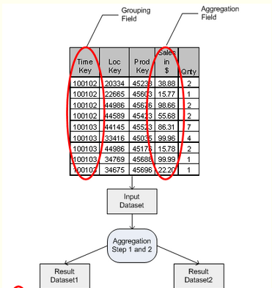
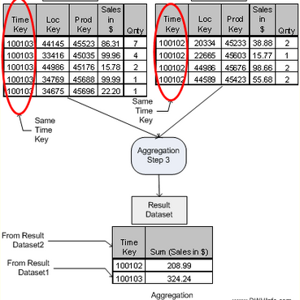
Aggregation

Slide 29
Types of Aggregation
There are many aggregation options available in ETL tools like
Summation
Maximum
Minimum
Count
But remember one thing, for accurate results the input of aggregator must be sorted on the grouping fields
To optimize aggregation , most ETL tools enforce that the input should be sorted and hash partitioned on the key columns

Slide 30
Test your understanding
When do we need a surrogate key?
What is the advantage of using Junk Dimension?
Why do we denormalize data?
What is the input requirement for aggregation?

Slide 31
Solution
When the Business key is not sufficient to identify table records uniquely
We reduce the number of dimensions and save space
For faster querying
Sorted & hash partitioned

